Slide 1


UNIVERSITY OF BASRAH / COLLEGE OF SCIENCE
SEPTEMBER 2023
LECTURE 1
BACTERIAL CLASSIFICATION AND NOMENCLATURE
Department of Pathological Analyses
Prof.Dr. Saad S. Mahdi Al-Amara

Slide 2
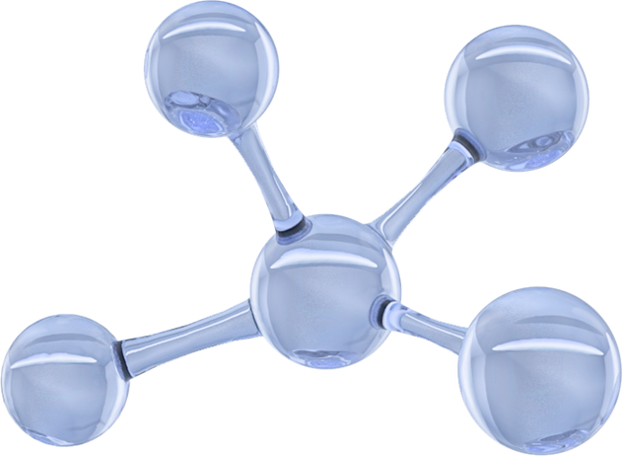

BACTERIAL CLASSIFICATION AND NOMENCLATURE
What is Taxonomy ?
✓ Taxonomy is the science of the classification of organisms, with the goal of showing evolutionary relationships among organisms.
✓ Taxonomy includes:
(A) Identification
.
(B) Nomenclature.
(C) Classification.

Slide 3
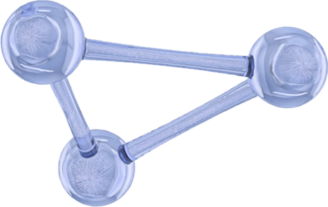
1
Identification
is the process of studying and recording the identical and distinguishing features
3
Classification
is a method for organizing microorganisms into groups or taxa based on similar morphologic, physiologic, and genetic traits.
2
Nomenclature
is the process of assigning taxonomic organism. Names ranking to of the each various living

Slide 4
Nomenclature
  is the naming of microorganisms according to established rules and guidelines set forth in the International Code of Nomenclature of Bacteria (ICNB) or the Bacteriological Code (BC).
•
  In this binomial (two name) system of nomenclature, every organism is assigned a genus and a species of Latin or Greek derivation.• Each organism has a scientific “label” consisting of two parts:
1. The genus designation, in which the first letter is always capitalized.
2. The species designation, in which the first letter is always lowercase.
  • The two components are used simultaneously and are printed in italics or underlined when written in the text.• For example, the streptococci include Streptococcus pneumoniae,
Streptococcus pyogenes, and Streptococcus bovis, among others.
  • The name may be abbreviated by using:
o The uppercase form of the first letter of the genus designation
o followed by a period (.)
o followed by the full species name, which is never abbreviated • Frequently an informal designation (e.g., staphylococci, streptococci,enterococci) may be used to label a particular group of organisms.• These designations are not capitalized or italicized.

Slide 5
Basis of Taxonomy
✓Phenetic system groups organisms :
based on mutual similarity of phenotypic characteristics. May or may not correctly match evolutionary grouping, e.g. motile v/s non motilebacteria.
✓Phylogenetic system groups :
organisms based on shared evolutionary genetic heritage.
Timeline
Taxonomy of bacteria
✓Living organisms were once divided into only two kingdoms: plantae and animaliae: bacteria, fungi, and algae were classified with plants; protozoa were classified as animals.
✓Haeckel in 1865 proposed third kingdom Protista for unicellular microorganisms such as bacteria, algae, fungi and protozoa.
✓ Bacteria were separated into the Kingdom Procaryotae or Monera in 1969 by Whittaker – five kingdoms

Slide 6
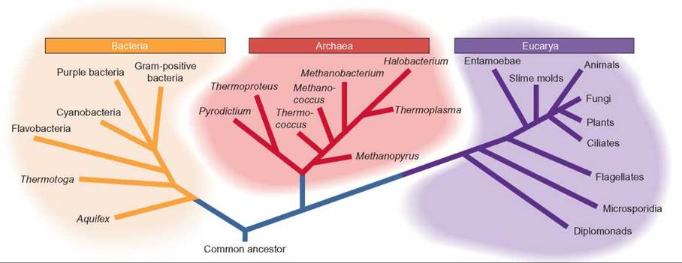

Slide 7
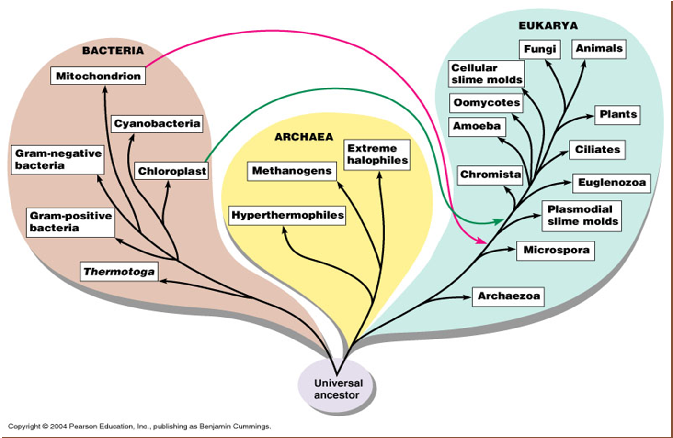
The Three Domains

Slide 8
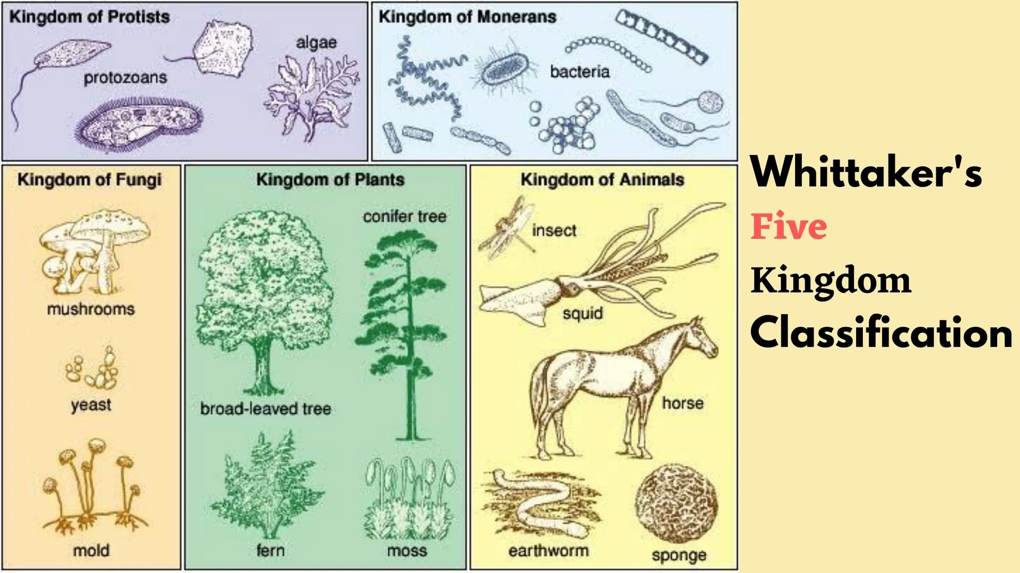

Slide 9
Taxonomy and Systematic
Taxonomy (Greek, taxis = arranged; nomos = law) is the classification of living organisms
into groups. It deals with
1.• Making and maintaining collection of microorganisms
2. Differentiating species
3. Identification (Keys) and diagnosis of species and genera
4.Naming and describing species and genera

Slide 10
Taxonomy and Systematic
Systematic (Greek, systema = a whole made of several parts) includes traditional
taxonomy with the addition of theoretical and practical aspects of evolution, genetics and speciation. deals with
• 1.Development of the classification of organisms
• 2.Species comparison and grouping into higher categories
• 3.Organisms are arranged in definite, hierarchical order
• 4.The order of the system is based on hypotheses of common descent

Slide 11
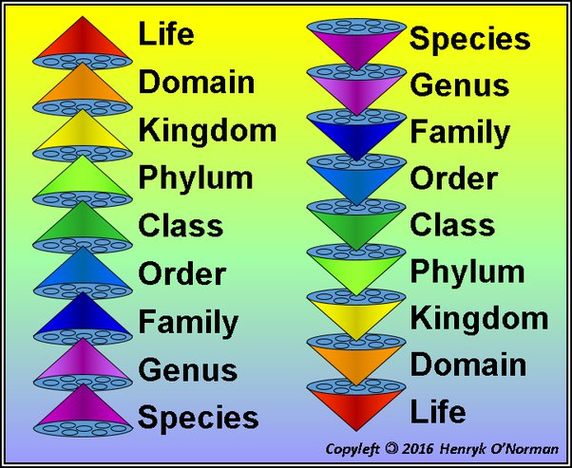
Levels of the Classification System
The classification of organisms takes place in the different taxonomic levels. They will be defined and listed according to The hierarchical classification system consists of the following taxa designations :

Slide 12

Domain
The domain classification is the highest level of taxonomic classification in the organism classification system. The domain can be broken down into three types: Archaea domain, Eukaryotic domain, and the (Eu)Bacteria domain.
Kingdom
The kingdom classification is the second-highest ranking in the taxonomic groupings of organisms. How many kingdoms are there? There are five kingdoms, though some recent studies have claimed six and seven kingdoms. The five kingdoms consist of the animals, plants, fungi, protists, and monerans.

Slide 13
Phylum
In the kingdom-phylum ranking system, the next classification is phylum. This taxonomic rank, sometimes termed as “division” lies after the kingdom and further classifies based on phenetic and phylogenetic. Phenetics is based on the number of shared characteristics using a numerical system and phylogenetics is based on evolution and shared relationships but using a systematic study. Each kingdom is broken down into numerous phyla. This can range from as few as four like in Kingdom Protista to as many as the nine phyla that kingdom Animalia contains.

Slide 14
Class
The class falls just between the phylum and order classifications. Just like kingdoms contain multiple phyla, each phylum can contain multiple classes. These generally end with the suffix “ae” when they are named. Sometimes, if classes are very large, they may be divided into subclasses.
Order
Order is the classification that consists of several families. Orders above the family classification and below the ranking of classes. An order consists of multiple families that share many characteristics and evolutionary traits.
Family
When a group of genera with similar characteristics and traits are pulled together it is called a family. The family is the ranking between orders and genus in the Linnean classification. Multiple genera make up a family group.

Slide 15
Genus
Genus is the systematic unit in the organism classification that helps determine the species of organisms as the genus groups multiple species together. A genus could also consist of one unusual species whose attributes are so unique it is classified on its own.
Species
Species classification is the final ranking for the biological classification of living things. A species is defined as a group of organisms with similar characteristics that are able to procreate or interbreed with one another.

Slide 16
THANK YOU

